Slide 1
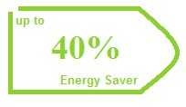
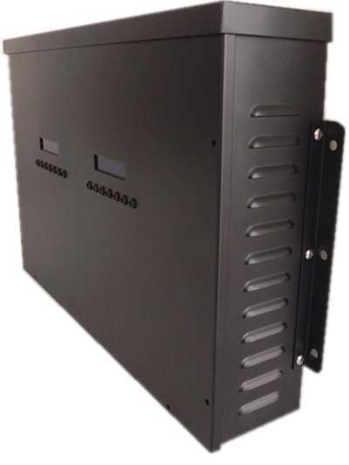
Huge Savings on your Monthly Electricity Bill
For Industrial and Domestic Electricity Consumption

Slide 2
About Us
Scotia World is an Integrated Information technology service provider dedicated in aiding businesses in Nigeria and around the world increase their profitability and efficiency.
Established in January 1996, we have grown to become a trusted partner of many businesses from small and medium enterprises (SME) to big corporations.
Our approach of deploying cutting edge next generation Internet Technologies combined with Internet Marketing and Creative Web Design, helps businesses enhance performance by leveraging the power of the internet to automate and extend their business processes online.
Our capabilities and extensive experience in the online market ensures our clients receive high quality and cost efficient business solutions designed, produced and developed by our knowledgeable and experienced web strategists.
We have a diverse team of experts including internet technologies consultants, interactive and web designers and online business management consultants, not to mention our friendly sales and customer-support executives.
At Scotia World, we are firmly committed to producing effective solutions. We pride ourselves on our ability to find the right solutions for all our customers and see the solutions through to its success, providing quality service throughout the process.

Slide 3
Advanced Power Saving Solution
Our Power Saver use a state of the electrical technology to actively monitor and improve the power factor of your household or office appliances. In addition, the intelligent technology optimizes the voltage and current demands thus reducing the active power/ KwH demands and achieves up to 35% savings on your electricity bill. It reduces waveform distortions. It also acts as a voltage stabilizer by storing energy for up to 10 seconds and therefore supplies the load with constant voltage during momentary power surges. As a result, this power saver prolongs the lifespan of the electrical appliances Super intelligent digital energy saving equipment It uses a state of the art electrical technology to actively monitor and improve the power factor of your household / office appliances. The technology optimizes the voltage and current demands to reduce the active power demands and achieves unto 35% savings on your electricity bill Lift the effectiveness of power usage and reduce the amount lost
Main functions 1. Save electricity (25-40%) 2. Legal, 100% safe. Environment friendly 3. Improves power factor of appliances and efficiency
4. Reduce electrical overheating 5. Stabilizes voltage 6. Eliminates overheating of wiring and appliances 7. Harmonizes electrical current
8. Earth Friendly
9. Easy to use, maintenance free

Slide 4
How Does Our Power Saver save Electricity?
Power factor is the percentage of electricity that's delivered to your house and used effectively, compared to what is actually wasted. For example, a 1.0 power factor means that all the electricity that's being delivered to your home is being used effectively by your appliances. However, most homes in Nigeria today have a 0.60 - 0.75 power factor or less. This means that about 60-75% of the electricity that is coming through your meter at your home is being used effectively, the other 25%-40% is being wasted by your inductive load caused by some appliances (air conditioner, refrigerator and any other appliance with inductive load). With a low power factor, the utility company has to deliver more electricity to do the same work. Now, with Power-saver, it helps to increase that power factor in most cases to 0.98, and increasing the effective use of your electricity and lowering your meter reading.

Slide 8
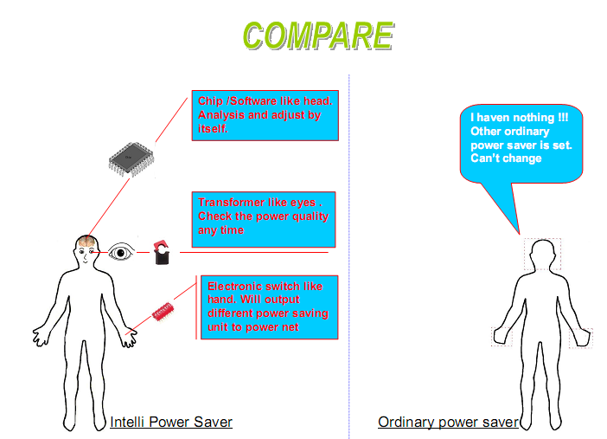

Slide 9
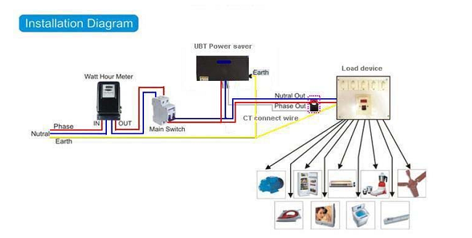

Slide 10
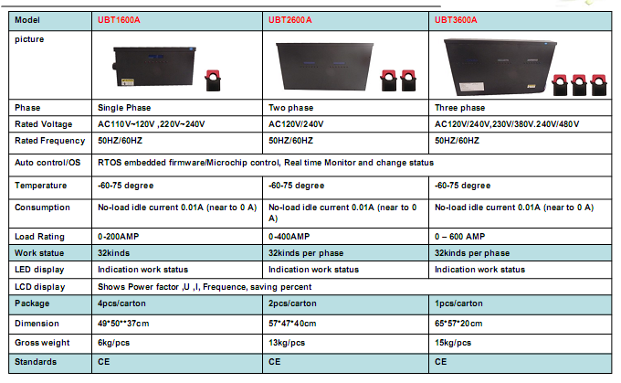

Slide 11
SCOTIA NIGERIA LIMITED.
38 Bimkol Cres, GRA 2, Port Harcourt, Nigeria
Email: james.sharp@scotia-world.com
Tel: +234 818 315 2433 / 0703 284 5561
URL: http://www.scotia-world.co.uk

