Slide 1


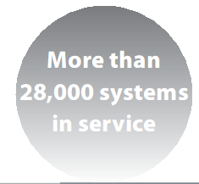
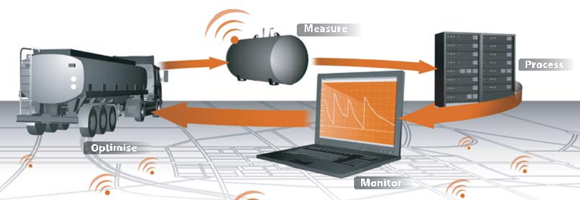

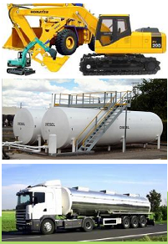
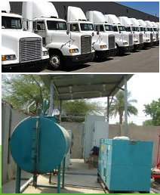
Stationary object monitoring:
- Fuel storage; diesel generators;
- Fueling and fuel distribution station;
Power transformers and power distribution station;
Remote Temperature & Weather monitoring;
- Remote Flowmeter Reading & Pump Control
- Fuel Bunker/Vessel Tracking & Content Monitoring

Slide 2
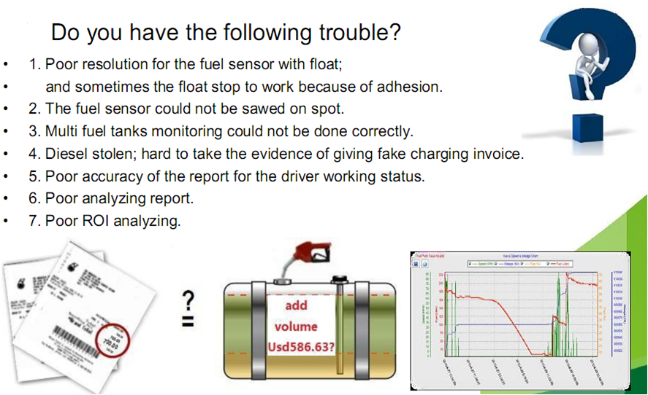

Slide 3
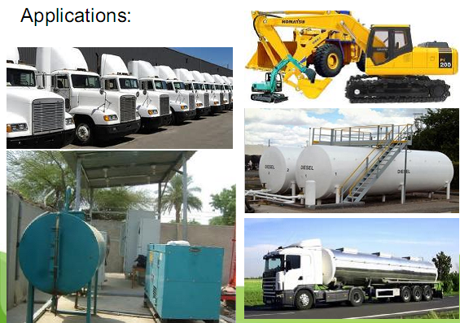
Nigerian based system integration and software development company with more than 10yrs experience in the field of telemetry, remote monitoring and satellite technology.
Our clients includes: chevron nigeria, schlumberger nigeria, technip, haliburton nigeria, scotia nigeria & uk, invensys, uk, scot oil and gas, usa, orient petroleum plc, nigeria,etc. our solutions includes: remote oil and gas telemetry gps satellite tracking online Genset & storage oil tank monitoring tank farm automation

Slide 4
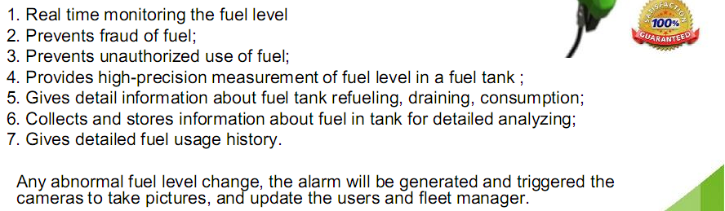
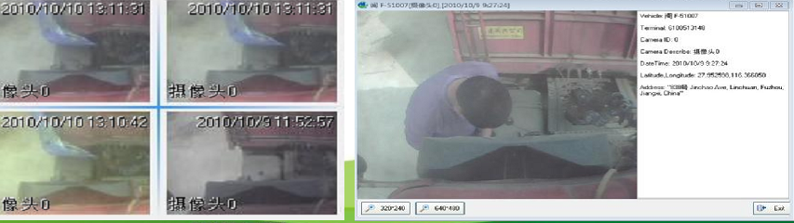

Slide 5
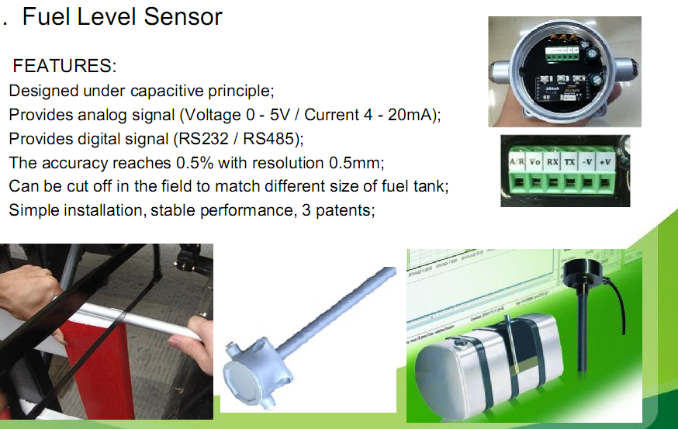

Slide 6
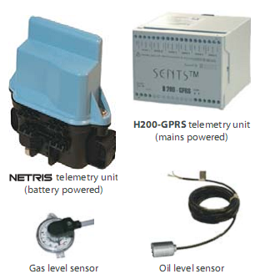
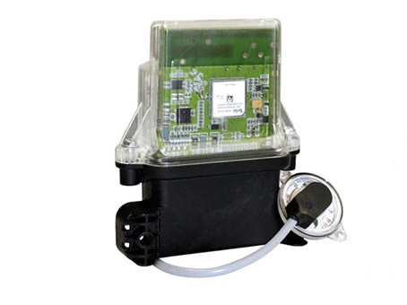
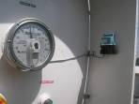
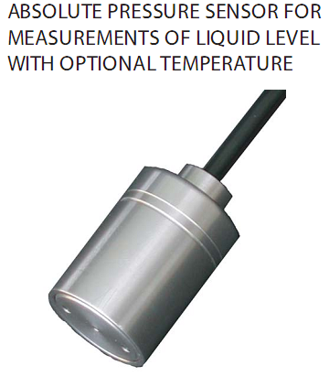

Telemetry Units & Sensors

Slide 7
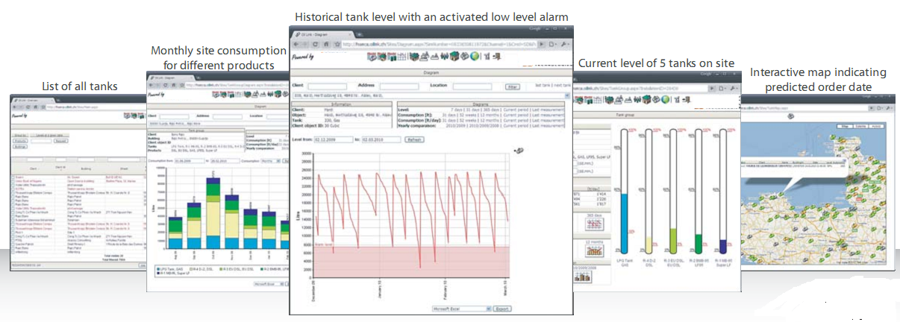
Software screenshot

Slide 8
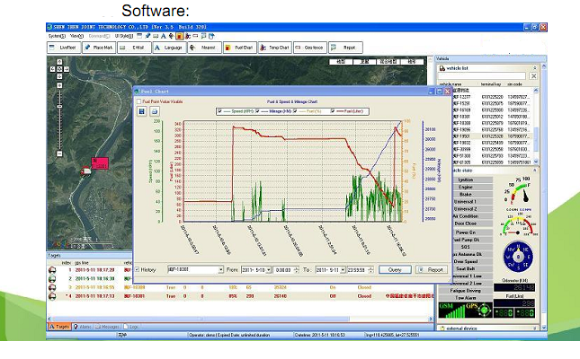

Slide 9
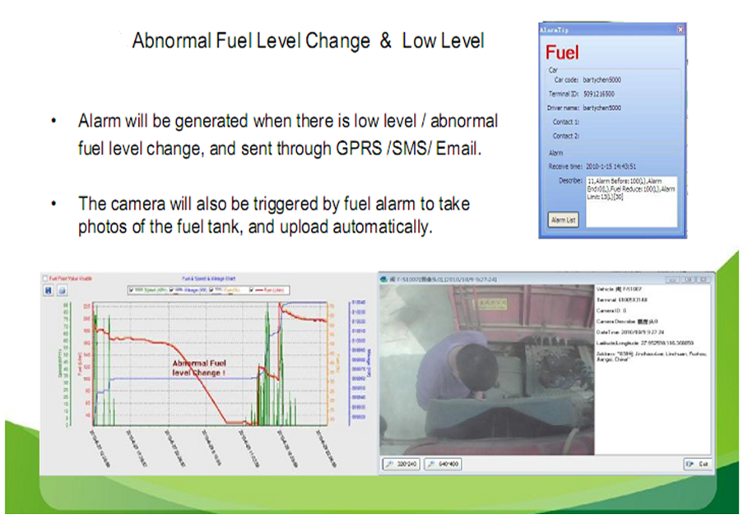
NEW PRODUCT VERSION WITH CAMERA FOR INCREASED SECURITY

Slide 10

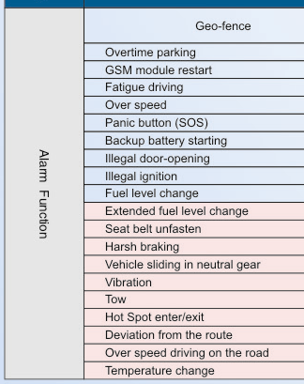
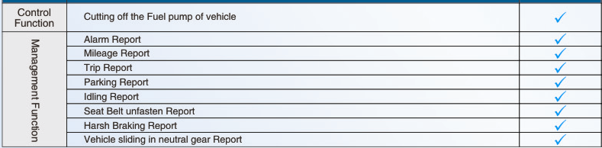

Additional solutions from our company
Advanced OBD Tracker
Key Specifications/Special Features:
Compact design
Supports Plug-and-play function
Standard OBD II parameters reading and transmitting
Engine DTC reading
Built-in GSM and external GPS module for real-time monitoring and data transmission
Built-in memory, 300 hours data storage on-board and unlimited data storage space on remote server
Built-in three-axis acceleration g-sensor module for illegal towing alarm
Driver behavior monitoring and remote report the hard acceleration
Hard deceleration, hard braking and idle engine
Speeding and fatigue driving alarm to monitor center
Automatically enters into power-saving state after ignition is off and automatically wakes-up when ignition is on

Slide 11
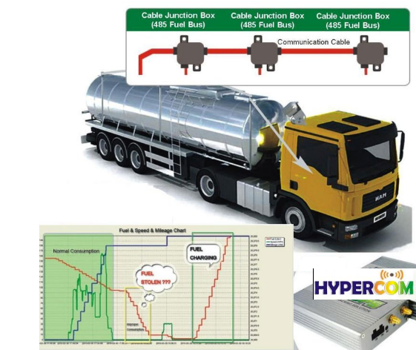

Fuel Delivery Tanker Tracking & product monitoring

Slide 12
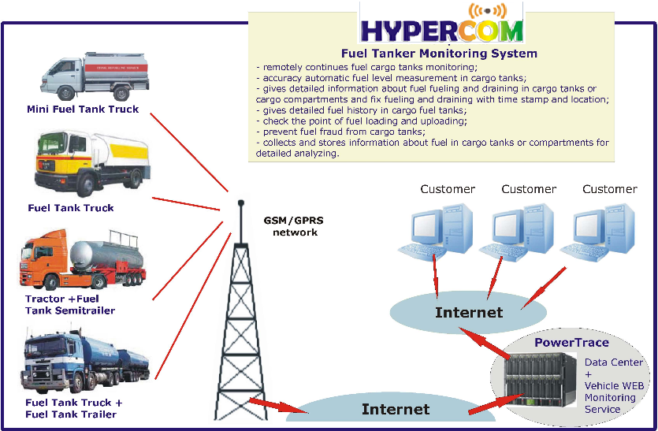

Slide 13
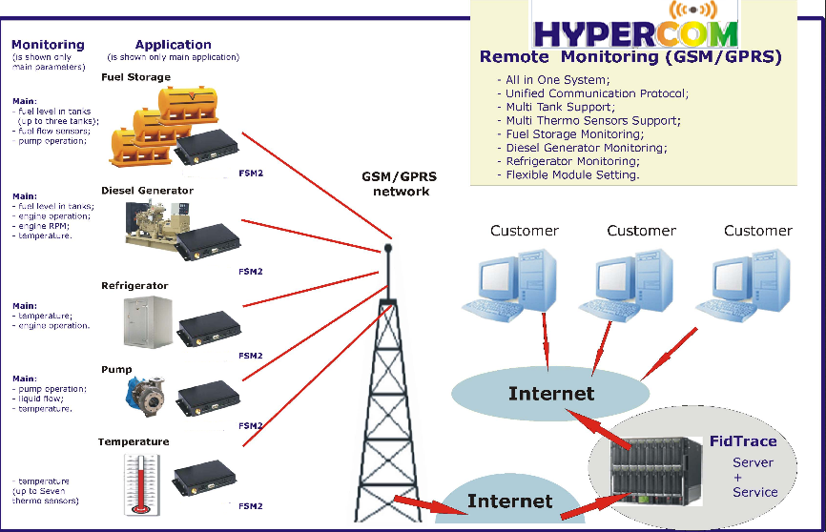

Slide 14
Contact ;-
James Sharp
Scotia Nigeria Limited.
Tele ;- +234 818 315 2433
james.sharp@scotia-world.com
james.sharp@scotia-world.co.uk

