Slide 1
SCOTIA Middle East Limited.
LAN Management
Using Internet Layer 8 Reporting

Slide 2
Agenda
1. Scotia Client Base.
2. Internet Layer 8 Reporting.
3. Technical Description Internet Layer 8 Reporting.
4. UTM Dash-Board.
5. Defining Objects.
Reports ;–
6.1 Dash-Board.
6.2 Report Samples ( 1 – 3 ).
6.3 Generated Reports.
Benefits of LAN Management System.
Proposal.
Any Other Questions.

Slide 3
1. Scotia Client Base.
UK British Foreign and Commonwealth Office ( FCO ) – Basra / Baghdad, Iraq.
Kyrgyz Republic Emergency Services.
Restoration of Emergency Services ( thro FCO / DFID )
Pakistan Restoration Emergency Services after Earthquake Oct 2005.
Setting up ERRC to ensure Transparency for Donators.
Setting up Emergency Telecommunications in Northern Pakistan.
USA Department of State, Washington / Baghdad Embassy.
- Setting up High Tech Security / Telecom Systems.
Oil Companies Shell / Chevron / Mobil / Texaco / Agip / Conoco Phillips.
Oil Service Companies Schlumberger / Intel / Willbros / African Oil Field Services / Weatherford / Dredger International.
Nigerian Government Projects PTF / NCC / NDDC / Niger Delta States / Alscon / Asferro / Le Meridien Hotel Uyo.
Airlines Lufthansa / United Airlines.

Slide 4
Summary.
Capability to provide a Priority to Internet / LAN users within the Company :-
Class 1 – Senior Management.
Class 2 – Middle Management.
Class 3 – Management.
Class 4 – Consultants.
Class 5 – Principle / Senior Engineers.
Class 6 / 8 – As Defined by the Company.
Barring of Internet Sites to all / dedicated Staff, during Working Hours :-
Chat Sites.
Yahoo.
Audio / Video Sites, ect.
Provision of Detailed Reports on Internet use, from the Largest User to the Least usage .
The Following Presentation provides the Detail of the above issues.

Slide 5
2. INTERNET LAYER 8 REPORTING……..
Internet Layer 8 Reporting entails reporting network activities referencing the Human Layer, that is identifying activities based on the users rather than confusing codes.
Current corporate policies surrounding network security often neglect the most critical and weak security component: the human element. An organization's overall security is only as strong as its weakest link – the user.
In order to address the concerns of gaining visibility and controls on user activity in the network, the Layer 8 technology has been derived out of the need for a more robust network security system which can include a user's human identity as part of the firewall rule matching criteria.
By definition, Layer 8 Technology treats user identity the 8th layer or the “human layer” in the network protocol stack. This allows administrators to uniquely identify users, control Internet activity of these users in the network, and enable policy-setting and reporting by username.

Slide 6
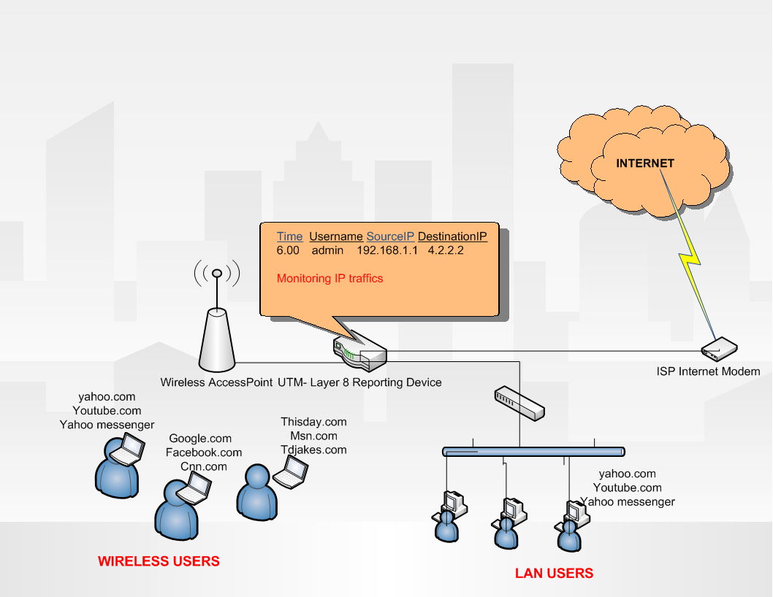
3. Technical Description Internet Layer 8 Reporting.
This is a simple example of a network system with UTM layer
8 Reporting.

Slide 7
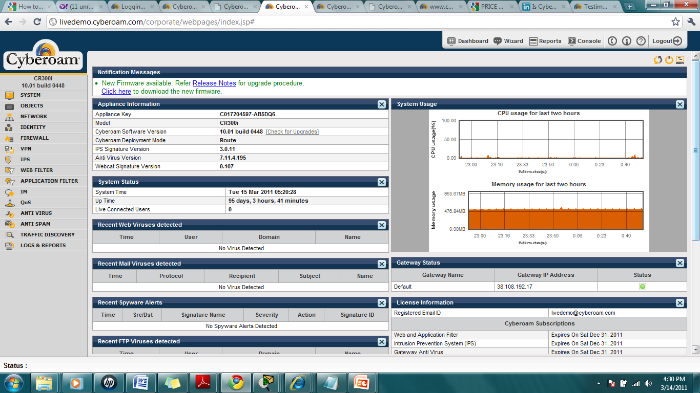
4. UTM Dash-Board.

Slide 8
5. Defining Individual Company Objects
Computer hosts and other devices in the network are been defined.
Internet connections services and connection schedule are also defined for hosts.

Slide 9
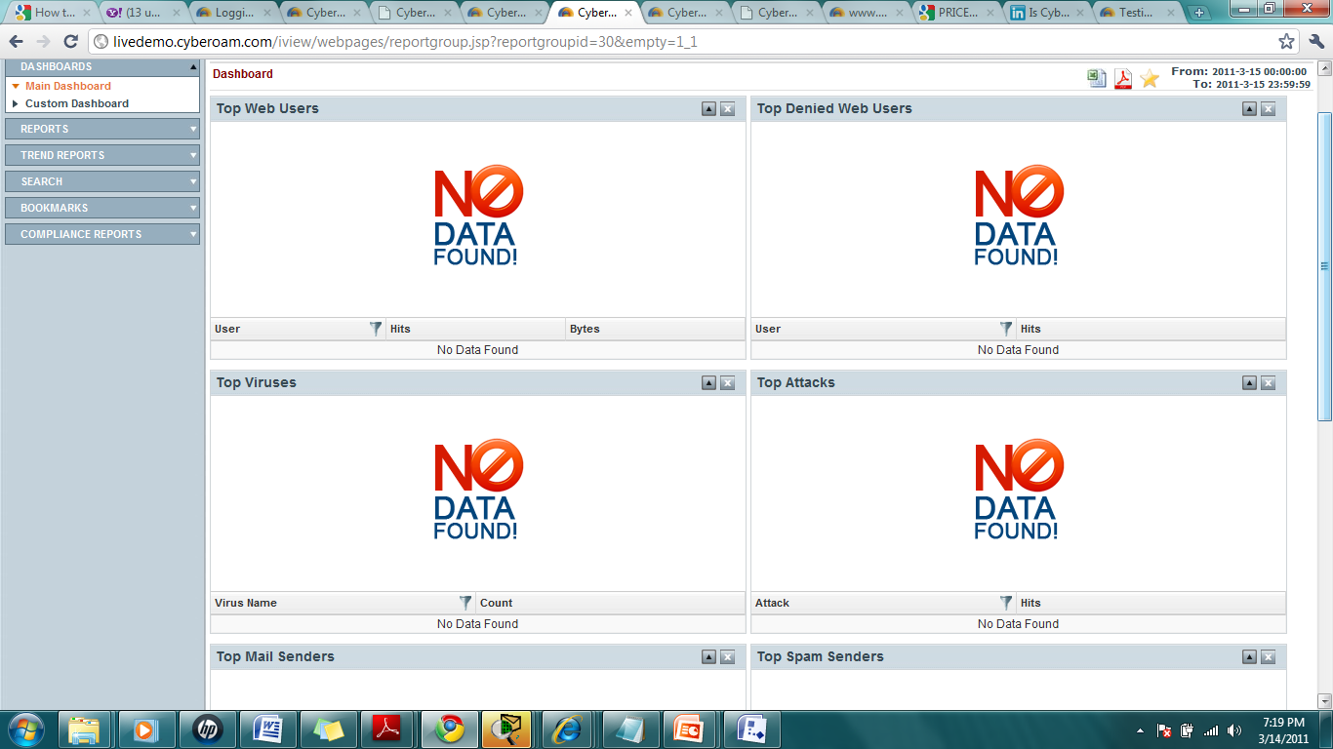
6.1 Reporting Dashboard.

Slide 10
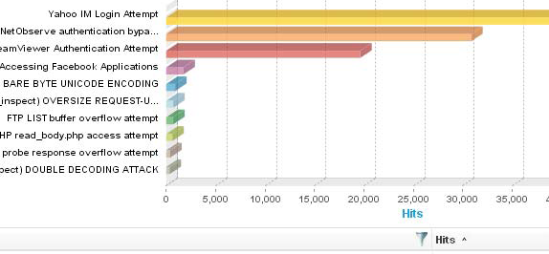
6.1 Report Sample Number 1.

Slide 11
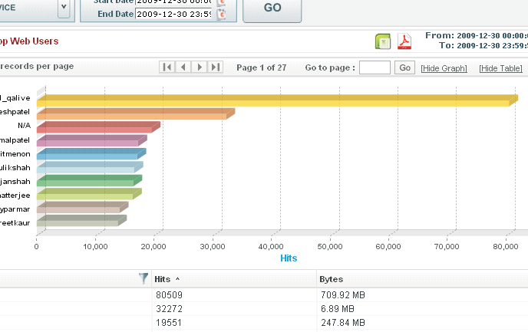
6.1 Report Sample Number 2.

Slide 12
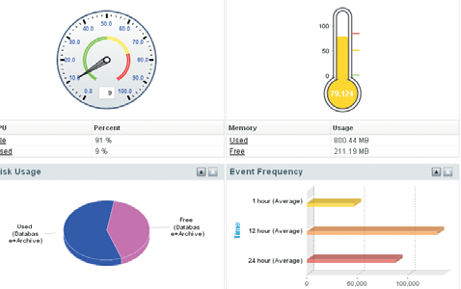
6.1 Report Sample Number 3.

Slide 13
6.3 Reports Available to be Generated ( Discuss with Management ).
Web Usage
Mail Usage
IM Usage
FTP Usage
VPN
Internet Usage
Blocked Web Attempts
Blocked IM Attempts
Attacks
Spam
Virus
Event
Search Engine

Slide 14
7. Benefits of LAN Management System.
Identification of attackers/victims with username.
Instant visibility for administrators into source of attacks etc.
Controlling who is doing what within the network.
Allowing creation of identity-based Company Policies.
Reporting to track identity-based usage, problems, intrusions ect.
Integrated Security over Single Device, all security features can be centrally configured and managed from a single firewall.
Layer 8 combines all security features thus enabling the administrator to control security policies including auditing for user movements joining / leaving / promotion within the Company etc.

Slide 15
Benefits….
Adding Speed to security – Due to the lack of granular identity features, IT teams often waste time in knowing source of attacks and attackers in case of a security incident. Since Layer 8 offers instant visibility into source of attacks while identifying victims/attackers by username, thus proactive remediation of security incidents.
Security in Wi-Fi environments – secures organizations in dynamic Wi-Fi environments where it’s not easy to trace users by IP addresses alone. It offers strong user authentication, Internet access controls and reports with identity-based approach and offers separate Employee / Management network access.

Slide 16
Benefits….
Boosting productivity – content and application filtering feature manages indiscriminate Internet surfing by users through custom policy setting for users and groups, thereby setting access limitations based on time duration and predefined blocked sites across 82+ categories.
User, time and role-based bandwidth management - this approach will prevents users from consuming huge amounts of bandwidth for non-productive surfing and downloads. Instant Messaging Controls allow the administrator to control who can chat with whom over text chat, webcam, file transfer. Users can be divided into classes where network availability could be based on user class level.

Slide 17
Benefits….
Logging and reporting – Layer 8 identity-based reporting, pinpoints precise network activity for each and every user. Its dashboard shows all network attacks on a single screen with third level drill-down reports (1000+ reports) for investigating the attacks, and the users behind them.
Regulatory Compliance – Through Layer 8 identification and controls, the appliances enable enterprises to comply with regulatory compliance norms such as HIPAA, CIPA, PCI-DSS, GLBA, etc.

Slide 18
Any Questions.

