Slide 1
Intelligent Non-Invasive Bomb Detection Solutions for the federal government of nigeria
Joshua A. Denila
Scotia Group (UK, Nigeria, UAE)

Slide 2
About Us
Scotia Group aims to build and offer a world class, technology driven and intelligent security-focused approach to our clients. We are a leading, global provider of integrated risk mitigation solutions to governments and multinational corporations.
The Scotia team offers risk and crisis management, technology-driven security systems, intelligent building, and intelligent transport system focused consultancy service to design and implement highly complex systems, dependent on the client’s needs. We provide best value to clients when engaged early on a project working from the inception of a scheme idea providing full technology lifecycle business case, feasibility, design, implementation and project management services.
Scotia Group maintains an independent position within the market to ensure that the solutions offered to clients are bespoke, meet with operational and technical requirements, whilst offering value for money. In addition to our familiarity with proven technologies, we maintain an active Research and Development Programme that ensures we maintain our market leading position of developing and deploying leading edge technologies that are innovative, cost efficient and appropriate to the operational needs. We are capable of developing technical solutions from grass roots as well as developing complex systems created through the seamless integration of technologies.
Scotia Group sets itself apart from other providers within the industry and is uniquely placed to support this project. We will draw upon a wide variety of relevant experience and specialist services from across the Scotia team. Our success is underpinned by the retention of skilled and experienced consultants with in-depth understanding of all key technical and operational issues coupled with an appreciation of risks influencing the project requirements. Scotia Group retains arguably world leading consultants in the areas of Risk and Crisis Management, Security Master Planning, Integrated Security System Design, Counter Terrorist Systems and Communications, Video Surveillance, Building Security, Access Control and Perimeter Protection.
Some key qualities comprise:
Multidisciplinary professional expertise across a wide range of technical, managerial and operational areas.
Totally independent advice (of suppliers, manufacturers and contractors) to our clients and are therefore able to develop the most appropriate solution for our clients.
An established track record in security strategy and technology.

Slide 4
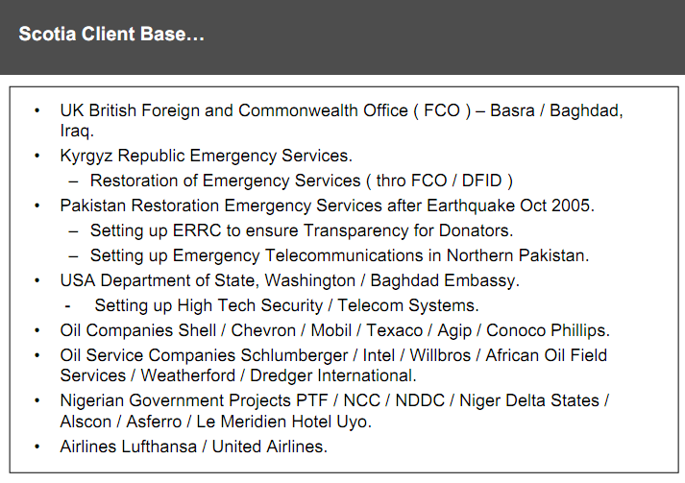

Slide 6
Technology Overview
Our next-generation detection technology is far more advanced than any other commercial product on the market today. The cornerstone of our Atometry technology is our revolutionary stoichiometric detection system which can non-invasively, and in real time, accurately decode and decipher mass and chemicals through metal, concrete, steel and other barriers.
This technology enables our detection devices to not only “see” through barriers, but to also perform advanced chemical analysis. While traditional explosives identification requires up-close and dangerous interaction with an undefined threat, our non-invasive detection devices provide greater safety for first responders by identifying the exact threat from a remote location.
To our knowledge, our Atometer detection devices are the only products in the market with this sophisticated stoichiometric capability, making our detection devices the most accurate systems available today.

Slide 7
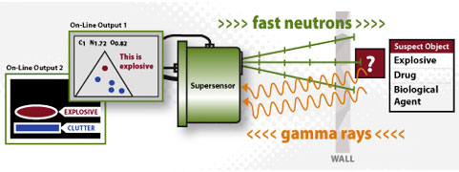
Technology (continued)
Our detection devices determine the chemical composition of a subject –– an abandoned suitcase, a suspected car bomb, etc. –– by irradiating it with fast neutrons which excite or activate its atomic structure causing the contents of the targeted object to emit gamma rays at varying energies. Gamma rays emitted by each substance carry unique chemical signatures. These signatures are then analyzed by our detectors as to the weight percentage of all elements present to decipher the chemical composition of the substance. Using our proprietary algorithms, a remote computer processes the data and yields a graph of the potential explosive or substance. The Graphical User Interface (GUI) tells the operator if explosives are present based on the ratios of elements, including Carbon, Nitrogen and Oxygen.
A 97% percent Detection Accuracy Rate

Slide 8
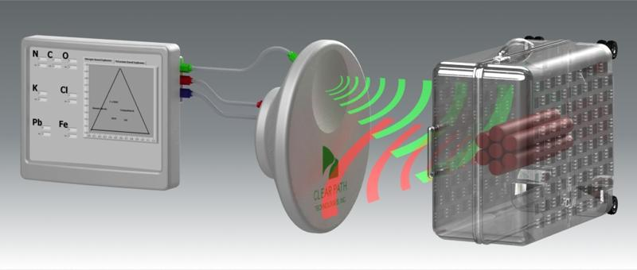
AtometryTM – “Over the Air Digital Chemistry”
Fast Neutron Activation Analysis
Ability to penetrate packaging and “see through” counter-measures, shielding masking or other barriers.
Non-invasive and non-destructive interrogation
Advanced High Energy Prompt Gamma Spectroscopy
“Chemical specific”, confirmatory detection
Proprietary “stoichiometric” technique” to decipher chemical formulas by weighting of elements present and matched to class of threat materials.
Unique volume selectivity with the ability to calculate risk based on mass.
Incorporation of the highest resolution detectors to significantly decrease false alarm rates (FAR).

Slide 9
What Does our solution offer
Intelligent solution for real time, accurate detection and identification of explosives, radionuclides, special nuclear material (SNM) and other threat materials.
Confirmatory results with highest levels of confidence or PoD (~97%) and minimal false alarm rates (~3%) in a matter of tens of seconds to several minutes.
Non-invasive and non-destructive “chemical specific” screening of discrete targets, whether shielded, masked, or contained in closed containers.
Quantifiable data for tactical decision making and strategic response, including composition and mass of threat materials, in a matter of minutes.
Automated remote screening of threat materials providing greater operator safety and security.
Ability to scan large areas by way of motorized tower and density locator.
Digital (Non-analog) data transmission over TCP/IP allowing information sharing, collection and archival for forensic, training, and incident auditing purposes, as well as data integration in advanced command and control systems.

Slide 10
Performance
Our AtometryTM-based systems are perhaps the only detection system of their kind that calculates its Probability of Detection (PoD) in real-time every second by way of sophisticated statistical analysis by way of AI and complex algorithms.
Interrogation results including PoD are a function of the target’s density, distance from detector and activation time (exposure to neutrons) also known as detection time.
Our systems for example can detect 40 Kg explosive like RDX in about 45 seconds from approximately 2 ft with 98% PoD with 2% false alarm rate (FAR). If the operator selects a lower PoD (confidence threshold) or there is greater amount of explosive or target is closer to detector, the detection time would be considerably less.

Slide 11
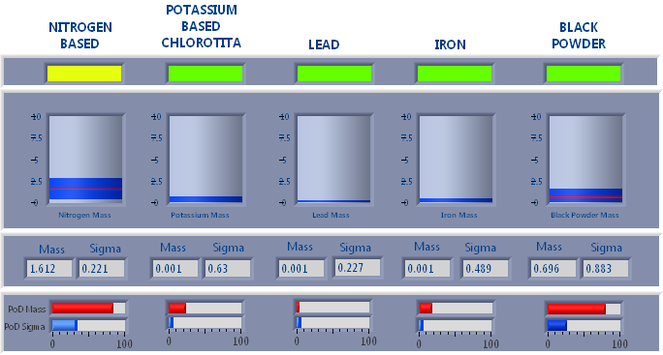
Explosive Element Detection Screen

Slide 12
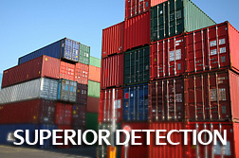
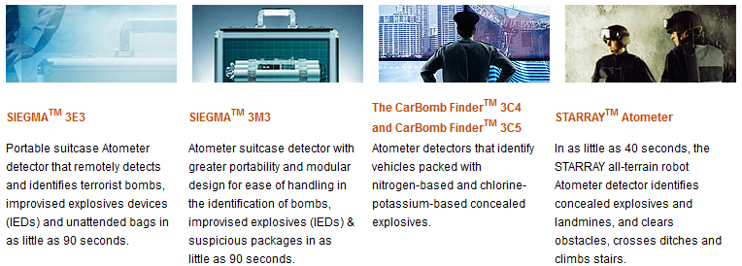
Product Summary

Slide 13
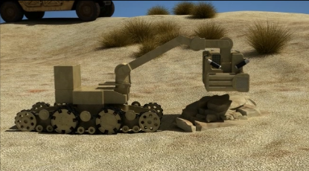
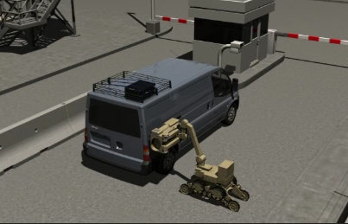
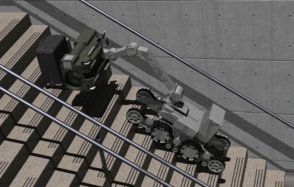
GIA STARRAYTM

Slide 14
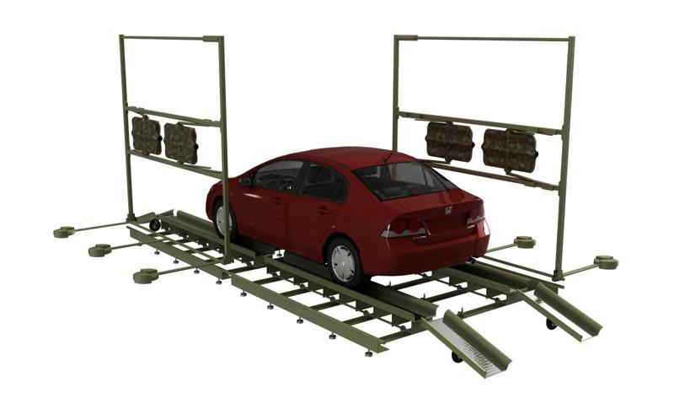
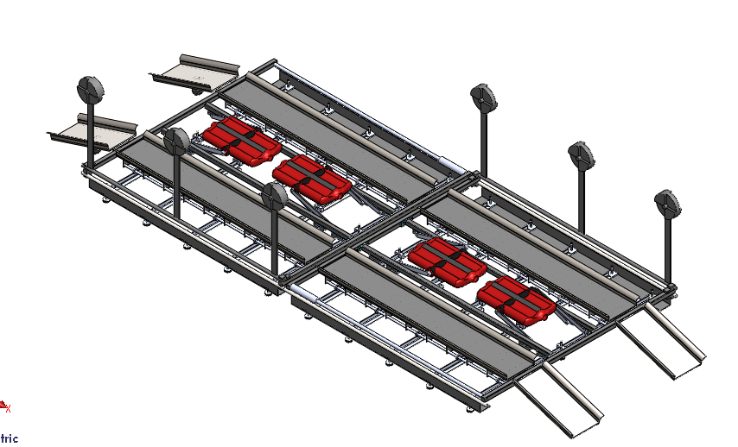
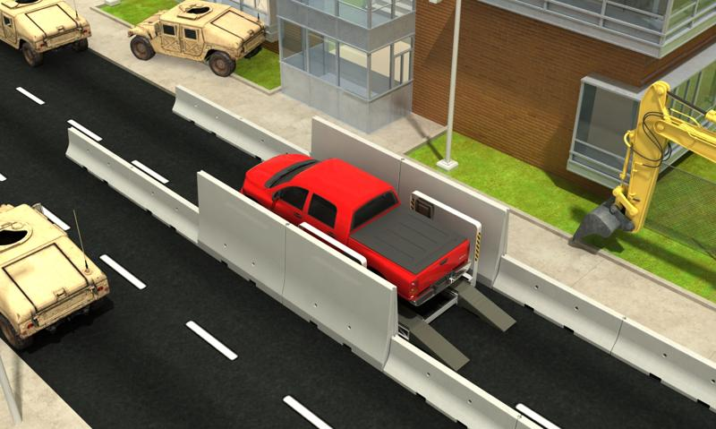
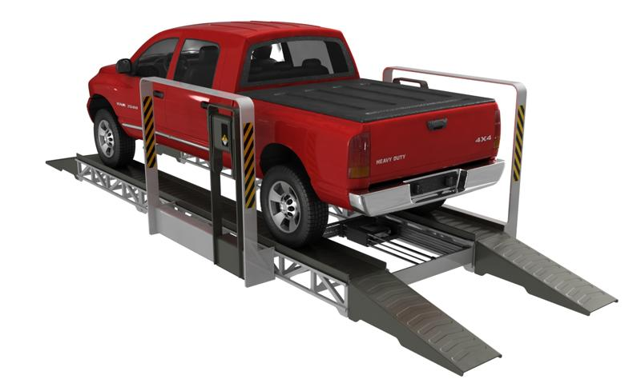
Automatic CarBomb FinderTM 3C6

Slide 15
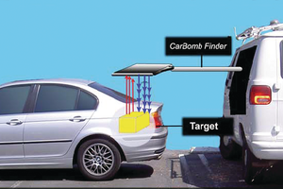
Car Bomb Finder 3C4

Slide 16
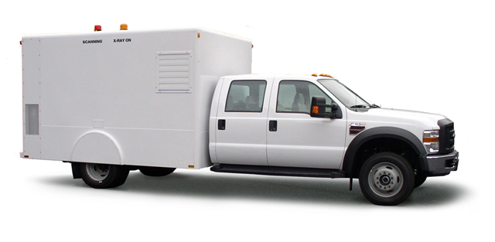
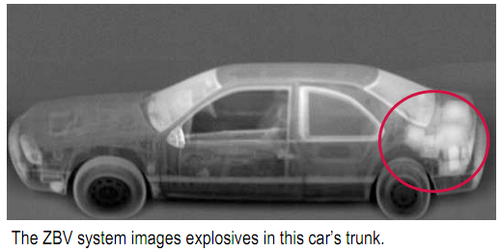
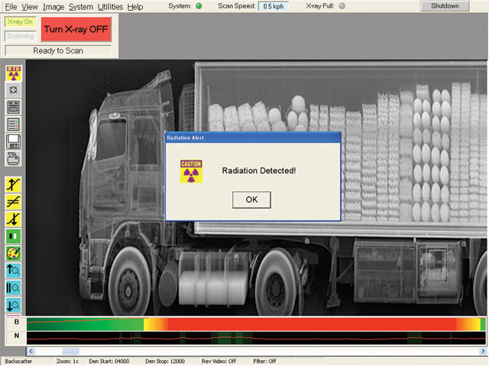
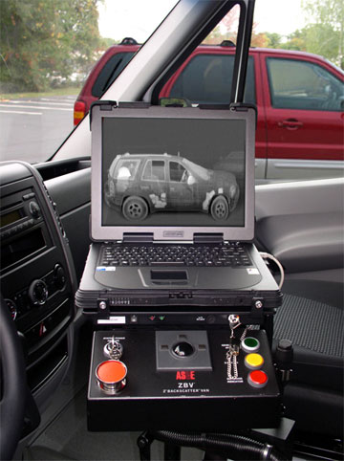
Advanced Detection Techniques

Slide 17
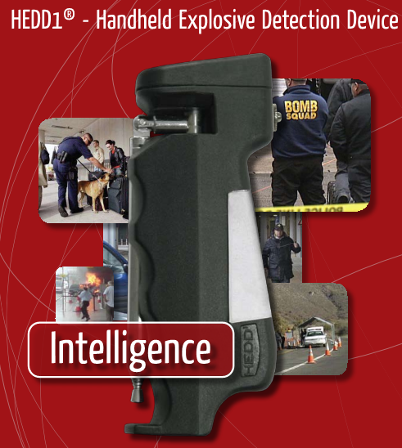
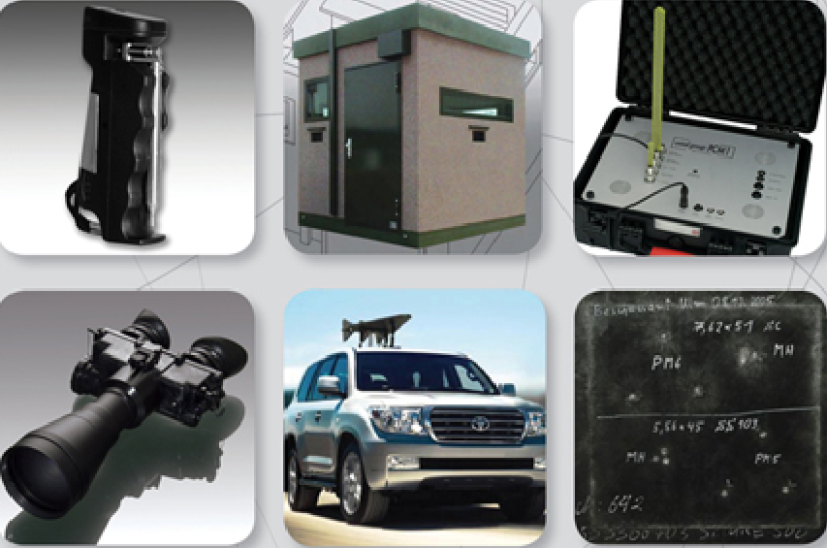
Lowcost Long Range Weapons & Explosives Detector

Slide 18
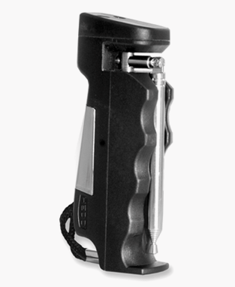
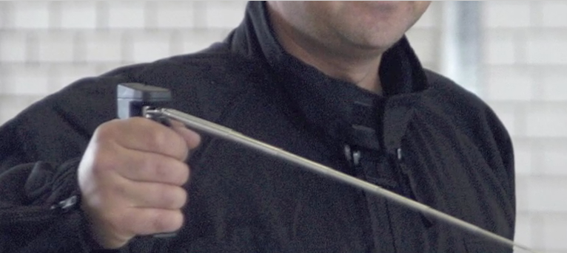
Highest Quality Hand Held Bomb/Weapons detector
HEDD1® is setting new standards in handheld explosive detection based on its unique patented Magneto-Electrostatic Detection (MED) method. HEDD1® forms a modulated Magnetic Field (MMF) that allows detection of all types of commercial and military explosives (TNT, Dynamite, Ammonite & Diesel, PETN, RDX, Gunpowder, Semtex, C4 etc.) including liquid explosives (TATP etc.) within a distance between 2-100 meters behind and through all types of barriers (including concrete, steel etc.).
Even weapons and ammunition will be detected, which makes HEDD1® also specially advantegeous for any police and military applications whether stationary or mobile.

Slide 19
Recent Case Study
Southeastern Pennsylvania Transportation Authority
Requirements
Non-invasive chemical-specific and confirmatory detection system to supplement primary screening methods with material identification and volume discrimination
Portable solution that could be deployed in multiple environments and address threats in situations (automobiles, ground, seats, railcars, buses, overhead compartments, etc.)
Stand-off interrogation of vehicles, unattended packages, cargo, and other suspicious targets, in non‐rectilinear conditions
Detection of IEDs, radiation dispersal devices (RDDs) and special nuclear materials (SNM), chemical(s), organic material whether shielded or masked with a high level of confidence and a superior safety factor
Small team deployment up stairs, down narrow causeways, over obstacles, etc. in variable and inclement weather and temperature conditions

Slide 21
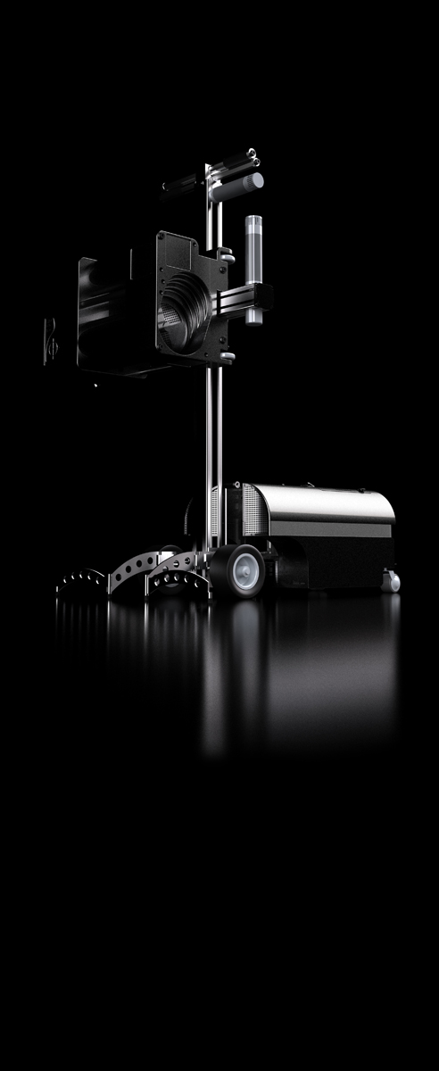
Thanks for Your Interest
Contact US:
Joshua A. Denila
+234-8033836341
Scotia Nigeria Ltd.
Nigeria 00234 703 284 5561
00234 818 360 5335
UK - Office
00441 357520890
UK - GSM
00447833738634
UAE - GSM
00971 50 7499424
Scotia Middle East FT Ltd.
admin@scotia-world.com

